Slide 1
NIVA RAdb - Web interphase/visualization
Knut Erik Tollefsen and Yang Li

Slide 2

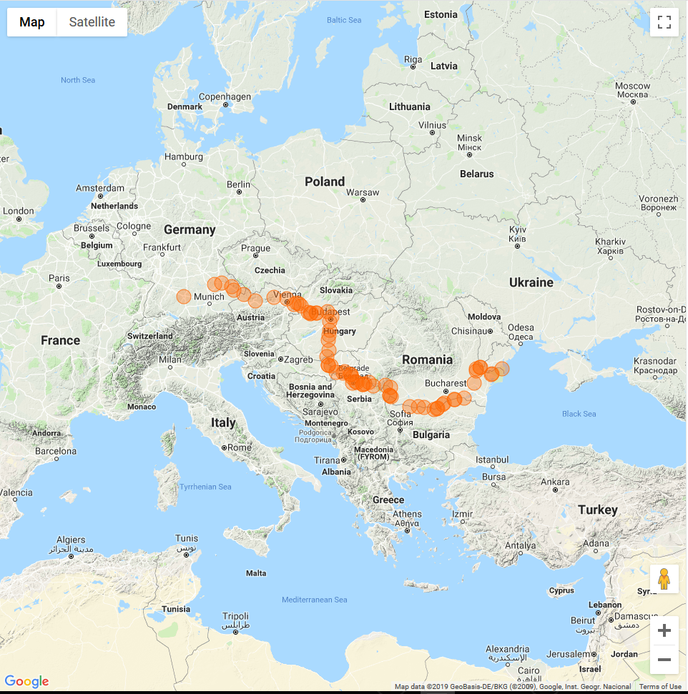
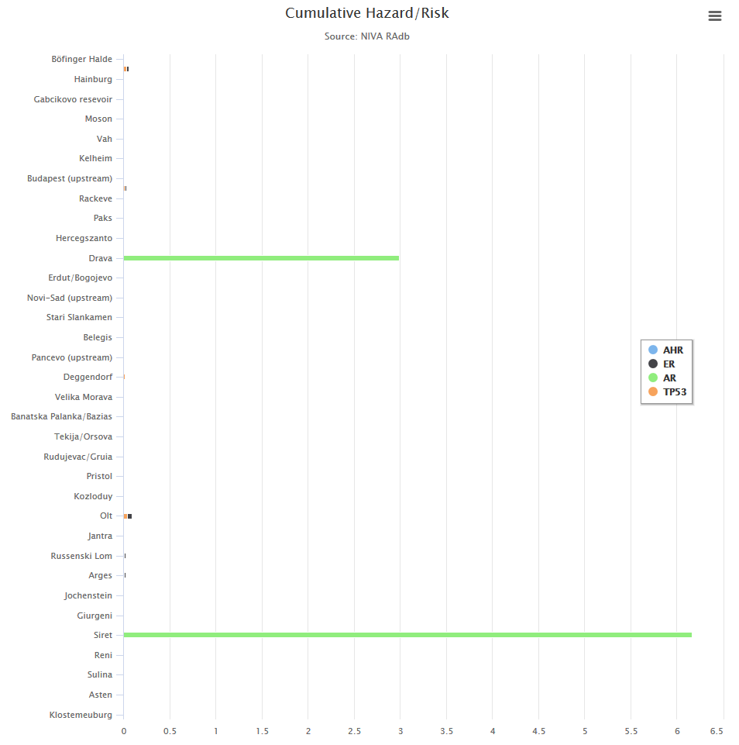



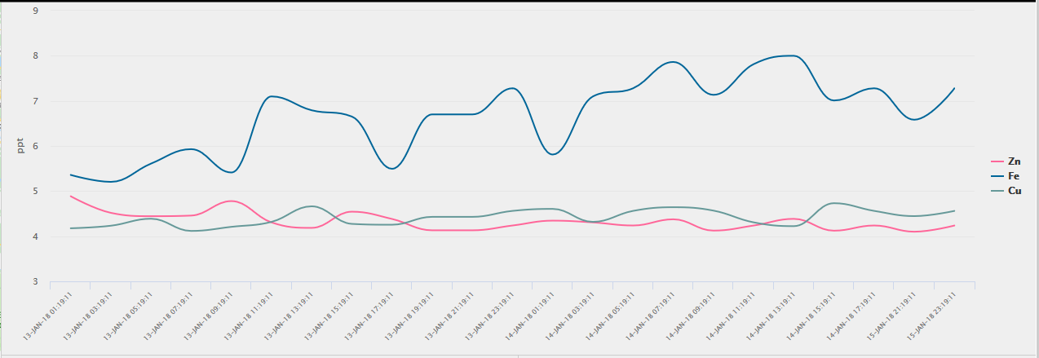
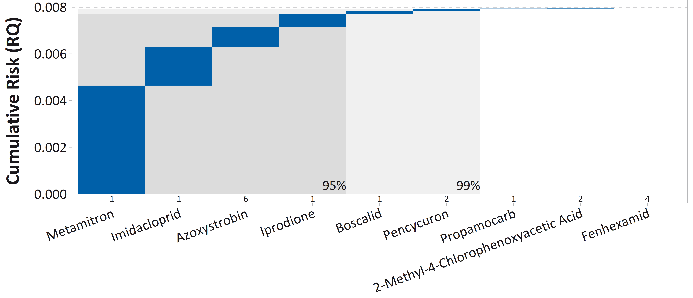
Web page design I
Top menues
(size as indicated)
Banner
(background black, white
Risk Assessment db
¤ SURVEY
¤ EXPOSURE
¤ HAZARD
¤ RISK
# EXPORT
# SETTINGS
Window 3
(CRA/CHA)
Window 1 (Spatial)
2/3 of size in height, ½ of width)
Window 2
(Temporal)
1/3 of size in height, ½ of width
Window 4
(Drivers)
Contact: ket@niva.no
2019@All Rights Reserved by NCTP (NIVAs Computational Toxicology Program, www.niva.no/nctp)

Slide 3
Web page design II
Explanations:
Individual selection panes for each window
(each window will have different content)
Print/download for each window
Expand window for each window

Slide 4
Descriptions I
Functionality: the web interphase should link directly to NIVA RAdb (Static ORACLE Views/materialized views in start and later as dynamic links directly to RAdb)
Top banner: Display NIVA logo pluss NIVA RAdb, Meny buttons to select: Survey (campaigne), EXPOSURE, HAZARD, RISK, EXPORT (TXT, CSV, xls, xlsx etc. for selection of data). Settings (Data to include and how to display them – to be defined).
Bottom banner: Contact, Copyright, NCTP web page.
Window 1 (SPATIAL data): display circles proportional to RQ value of selected data (data reflecting selection in meny: Survey, Risk/HAZARD/CONC). All locations displayed for selection, pop-up/hover over window that reflect the combination of selections made (default setting used at start-up). When having temporal data, selection in Survey defines data to display (earliest date). Default start-up for RQ reflecting the CRA/CHA is PNEC/EQS. When clicking on location, all settings for TEMPORAL, DRIVERS CRA/CHA are changing to reflects this dataset.
Window 2 (TEMPORAL): as for spatial, but reflecting temporal variation as a slider function. Default start-up is PNEC/EQS, and when selecting under CRA/CHA, the individual data sets are displayed for the selected survey. When using multiple selections for data sets in CRA/CHA, these are all added to TEMPORAL as separate lines with different colors (colors the same as used in window 3). Time slider function allowing to walk along the timeline and the size of the circles in SPATIAL and the sizes of Bars in CRA/CHA and graphs in DRIVERS updated. Pop-up windows reflect the selection in CRA/CHA (PNEC/EQ at start-up, selection when changing)
Window 3 (CRA/CHA): Meny-based selection of data to display. Start-up = PNEC/EQS. Selecting update stacked columns to selection. Meny reflecting species, ENDPOINTS and EFFECT (pop-up?). Data used for W1 (SPATIAL) , W2 (TEMPORAL) and W4 (Drivers) reflecting the selections.
Window 4 (DRIVERS): Meny based selection of analysis to be performed (ranked (CONC, RQ; using SRQ and RT), SSD/GENES (Dependent on selection in top meny). Specifications of location (W1), Date (W2) and species/endpoints from CRA/CHA (W3) are required to display the graphs. Default value is PNEC/EQS, using MEC95 for the entire period (survey). These graphs will be made in R (almost done) and integrated into window, if possible. If not possible, we can try to make them in other programs.
Default values at start-up: PNEC/EQS using MEC95 for the survey and time (Worst-case scenario), Updated when selections are made either in SPATIAL, TEMPORAL or CRA/CHA.
Default for maps (At start-up): RQ derived from MEC95 (Time+locations), EC = PNEC/EQS for SURVEY. selection made for other analysis in CRA/CHA. Default CRA/CHA=PNEC/EQS, when removed, aggregated = all in aggregate plot, default temporal= is using PNEC/EQS values before selections are made

Slide 5
Descriptions (menues)
Each individual window will have a meny to select data to display, a print/download menu and an expand function so can blow up the windows
Window 1 (Spatial): meny selection/buttons for EXPOSURE, HAZARD and RISK (similar choices can be made from top banner). Default setting is MEC (EXPOSURE), HQ Median (HAZARD) and RQ Median (RISK) – using MEC95 for the entire survey Time (Example: one season). Selection of time in W1 hover-over function, or selection of SPECIES, ENDPOINTS, EFFECT_TYPE from CRA/CHA (W3) updates the circles and the data in the boxes . Data in boxes are default unless specific choices are made in CHA/CRA/EXP (HAZARD/RISK/EXPOSURE).
Window 2 (Temporal): meny selection/Buttom for different locations in survey. Default setting is MEC95 (EXPOSURE), HQ Median (HAZARD) and RQ Median (RISK) – using EQS/PNEC for the HQ and RQ estimates for all locations (using MEC95 and EQS/PNEC). Single or multiple selections of SPECIES, ENDPOINTS, EFFECT_TYPE from CRA/CHA (W3), single locations from map by clicking (W1) will select the right data to display in W2.
Window 3 (EXPOSURE, HAZARD, RISK) : meny selection/Buttom for EXPOSURE (Pop-up for Water, sediment, air and terrestrial . Only use water for now), Hazard (pop-up for species/species group, EFFECT_TYPE and EFFECT_DESCRIPTION) and risk (pop-up for species/species group, EFFECT_TYPE and EFFECT_DESCRIPTION). Defauls showing MEC95 for the entire survey time as basis for EXPOSURE, HAZARD, RISK.
Window 4 (Drivers): meny selection (SSD, RANK, WATERFALL, STACKED). Default: MEC95 for time and spatial. Selection of one or more menues in separate windows update the data (W1 =>use MEC95 for time, W2=> use MEC95 for all locations), W3: MEC95 for survey time and locations, Combinations: W1+W2=> Site and time-specific EXPOSURE; HAZARD and risk estimates (PNEC/EQS?). W1+W2+W3: for different locations in survey and specific data sets for exposure, hazard and risk.

